Slide 1


“ However automated the work or standardised the procedures, people bring organizations to life. What people do - up and down the hallways and up and down the organizational structure, all day long, is talk..”
[Boden 1994 p23]
What is all this talk
about??????????

Slide 2
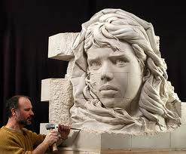
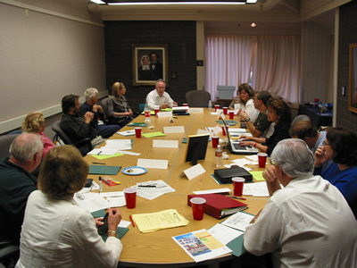
The Nature of Managerial Work
No matter the grand designs, structures and aspirations all of that that emerges is a product of the moment by moment conduct of the people of the organization
The moment by moment ‘managing’ crafts and re-crafts the business every day
Right Thought, Right Talk, Right Action
@ Right Time

Slide 3


Peeling the Managerial Onion
CONDUCT
The purpose of the torrent of talk
THE SUBSTANCE
OF MANAGERIAL
CONDUCT
OUTCOMES
BEHAVIOUR & ACTIVITY

Slide 4

The Nature of Managerial Work
We contend that the essence of managerial work, the very substance of a manager’s conduct, is the process of shaping and sustaining promises
WHERE IS DECISION MAKING
IN ALL OF THIS YOU MIGHT ASK

Slide 5
The Nature of Managerial Work
The term ‘decision’ is simply how we label the transition from the ‘shaping/capturing’ to the ‘sustaining’ of promises
SHAPING &
CAPTURING PROMISES
SUSTAINING PROMISES
DECISION

Slide 6
The Nature of Managerial Work
Promises are the links in the means-ends chain
Promises are what fills the white space of the organization chart
Promises are the ‘currency’ of collaboration

Slide 7
The Nature of Managerial Work
Promises are the objective-laden seeds of action.
  Undertakings through which someone agrees / accedes to endeavour to do, or forbears to do, ‘something’

Slide 8
Promises in the making
“So...what they’ve said to me is that if we put it up to twenty sites they’ll strengthen the [F] branding...so.. can you work with [A] today and get back to me with a cost...it’ll have to come out of your [Z] budget though! ”
“..on [Customer A] are we spending or aren’t we..on [Customer B] I’ve said don’t spend any money.... these are the ones we’re gonna invest in..yeah....and these are where we’re not gonna spend money”

Slide 9


The Dimensions of Promises
What, Who, When and How represent the four central dimensions in which promises are specified.
The ‘who’ requires a little of our attention

Slide 10
The Dimensions of Promises
  Only individuals can make promises
    even though they may do so on behalf of a potential ‘collective’
  Roles, jobs, organizations, functions, departments etc. etc. cannot make or capture promises
PROMISES HAVE A WHO TO WHOM CHARACTER

Slide 11

The Dimensions of Promises
The frequency and rapidity of organizational change often make ‘the who’ highly problematic, with carefully crafted webs of promises rapidly disintegrating when key personnel ‘move on, up, or out’

Slide 12
Types of promises
  promises to allocate resources
    Financial
      e.g. ‘Zeb OK!!..we’ll buy it’
    Human
      e.g.‘ I’ll put Stewart on the delivery failures full time’
    Priorities / sequencing
      e.g. ‘Tony, let’s kill this off first eh?”
    Attention
      e.g. ‘we will need to watch the numbers carefully’

Slide 13
Types of promises
promises to:
  Execute a physical act
    e.g. ‘Come on Martin, just sign the contract’
  Execute a cognitive act
    e.g. ‘I’ll think about it and get back to you’
  Exhibit a certain behaviour
    e.g.‘not quite the way we see it, but we’ll support you at the board meeting’

Slide 14
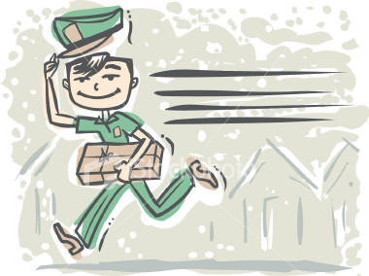
Types of promises
  Endeavour to achieve a projected outcome
    e.g. ‘We’ll do whatever it takes to get the product there”
In essence all forms of promises are of this form as they all represent promises to endeavour/try to take action of a certain form.

Slide 15
Types of promises
  Engage in the shaping and sustaining of promises
    e.g. ‘ no problem…I’ll get John to talk to operations and get a plan together’
  That is to engage in ‘MANAGING’
    AS ‘MANAGING’ IS THE SHAPING AND SUSTAINING OF PROMISES

Slide 16
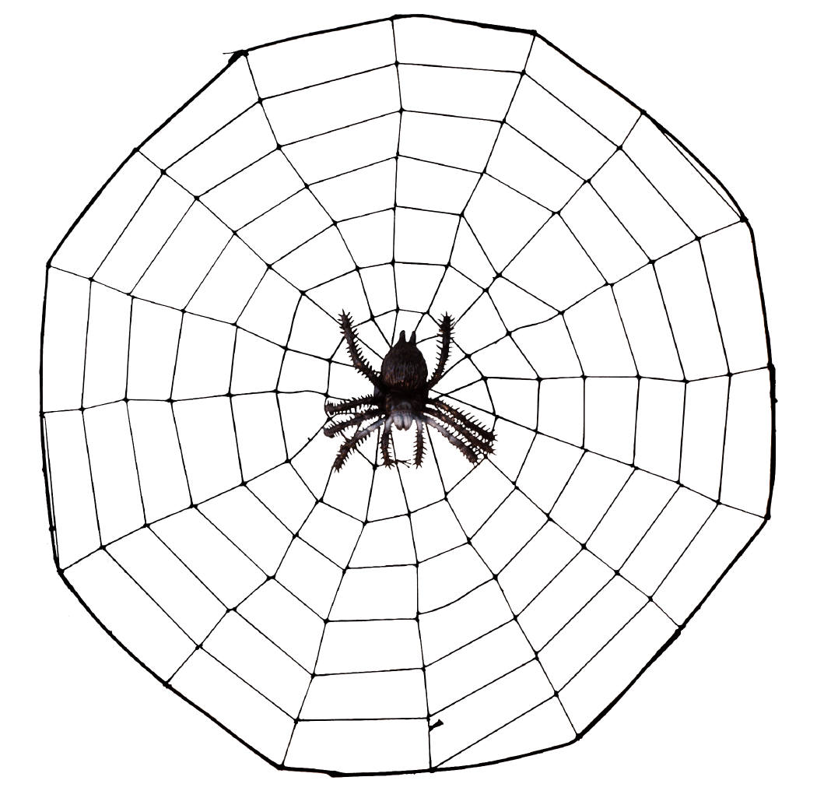
The Nature of Managerial Work
  Plans/strategies can be seen as webs of promises
  ..and….

Slide 17

Managing-Organising
- the shaping and sustaining of promises -
people
promises
P5
P6
P9
P6
P8
P1
P5
P6
P11
An Organisation
- a network of promises

Slide 18
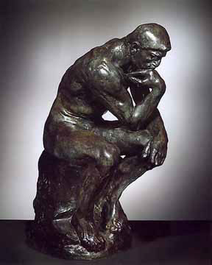
The Nature of Managerial Work
promises are fundamentally social
  They are inter-cognitive
Intentions intra-cognitive.

Slide 19

The Nature of Managerial Work
Expectations are the flipside of promises.
promises generate expectations

Slide 20

The Nature of Managerial Work
  Expectations represent the vital assumptions with regard to one’s collaborator’s projected actions that underpin collective endeavour.

Slide 21
The Nature of Managerial Work
INTENTIONS
PROMISES
EXPECTATIONS
INTRA-SUBJECTIVE
INTER-SUBJECTIVE
INTRA-SUBJECTIVE

Slide 22
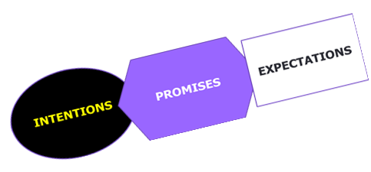

Organization
individuals
promises
P5
P6
P9
P6
P8
P1
P5
P6
P11
C10

Slide 23
INTENTIONS
EXPECTATIONS
PROMISES
Actions arisng

Slide 24

Promises exercise
30 = 15 + 15
The character of the promises you want to shape and capture

Slide 25
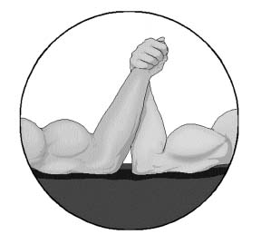
Properties of promises
promises are made with differing degrees of commitment:
“...just fed up of people agreeing then doing exactly the opposite...I’m gonna get some kind of electrocution system.....”
promises possess differing ‘strength’.

Slide 26
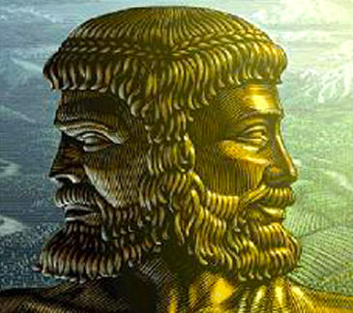
Properties of promises
As we all know from often bitter experience, an individual’s intentions may not necessarily be congruent or consistent with their manifest promises.
  ‘Authenticity’ is hence a much sought characteristic of promises.

Slide 27
Properties of promises
“...just fed up of people agreeing then doing exactly the opposite...I’m gonna get some kind of electrocution system.....”
one seeks strong authentic promises..and even then…..

Slide 28
Properties of promises
promises lack ‘durability’
“ ..we actually put our bid in for [T]...and got it over [Competitor A]...now in a state where we’ve got it, but I’m sat here thinking should we have it...’cause not sure people support it now”
“Activity was due to start middle of July, that’s what we’d told the retailers,... but then there was feedback from the factory...there was problems..wouldn’t hit… ‘til end July...all the media had been booked so...”
“..the budget we set out with,.. for the [D].., they’re saying they now can’t work to that budget”

Slide 29
Properties of promises
The accidental, or deliberately malicious, lack of fulfilment of promises does contribute to the vulnerability of collective endeavour
However………

Slide 30
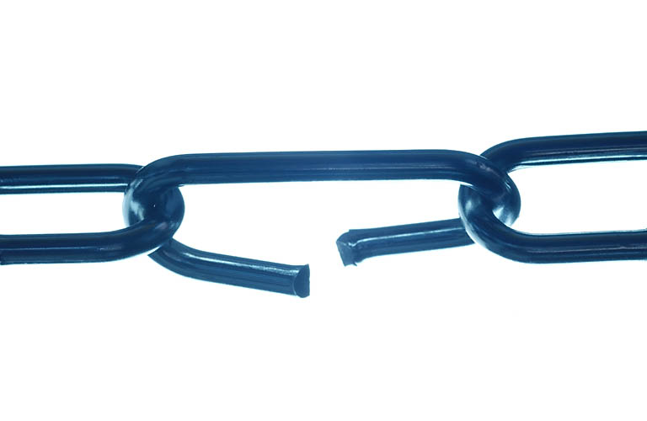
Properties of commissions
Most of the promise instability that managers face derives from:
  ‘changes of mind’,
  ‘changes of situation’,
  ‘unexpected outcomes’ and
  unintended consequences inherent in the turbulent ‘wicked world’ managers inhabit.

Slide 31
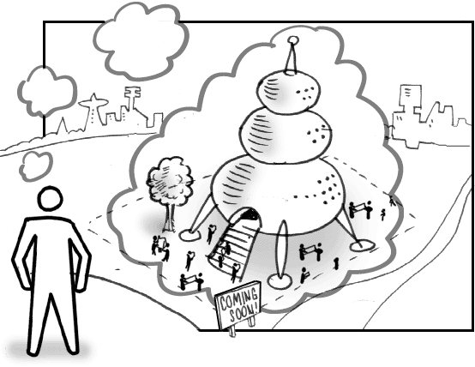
The Nature of Managerial Work
The OBJECTIVE embedded in a promise represents its SPIRIT
Objective-laden seeds of action

Slide 32
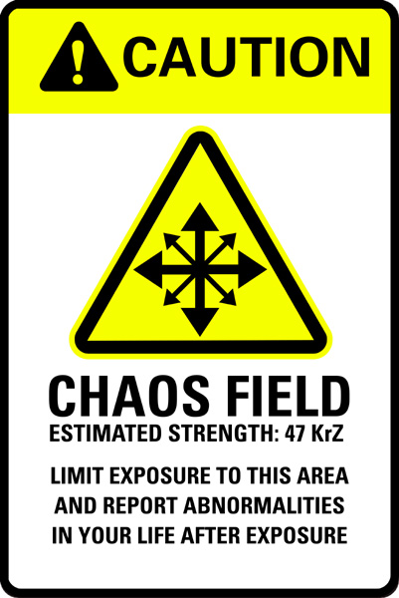
The Nature of Managerial Work
Given the turbulence, indeterminacy and complexity of the intra and inter-organizational wicked world it is in the ‘spirit’ of their promises, not in their detail, that managers need their collaborators and customers to act.

Slide 33
The Nature of Managerial Work
The most ‘reliable’ of promises are quite possibly those where the spirit of a promise is at the centre of its capture/acceptance/fulfillment and where its specification is detailed enough to enable coordination but soft enough to enable flexibility.
These we have come to term:
  ‘robust promises’.

Slide 34
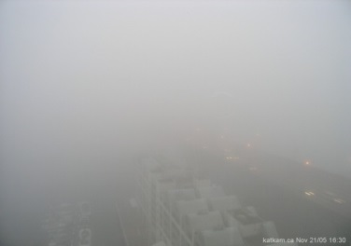
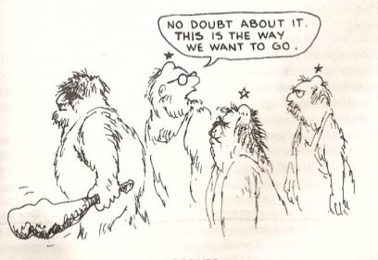
The Nature of Managerial Work
AUTHENTIC
ROBUST
PROMISES

Slide 35
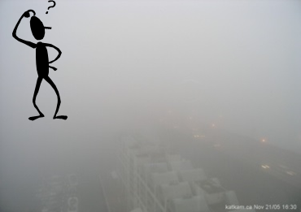
The Nature of Managerial Work
IN THE PUSUIT OF AUTHENTIC
ROBUST PROMISES
QUALITY DIALOGUE
IS CRUCIAL

Slide 36
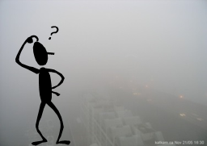
The Nature of Managerial Work
QUALITY
CONCORDANCE

Slide 37

The Nature of Managerial Work
TRUST

Slide 38
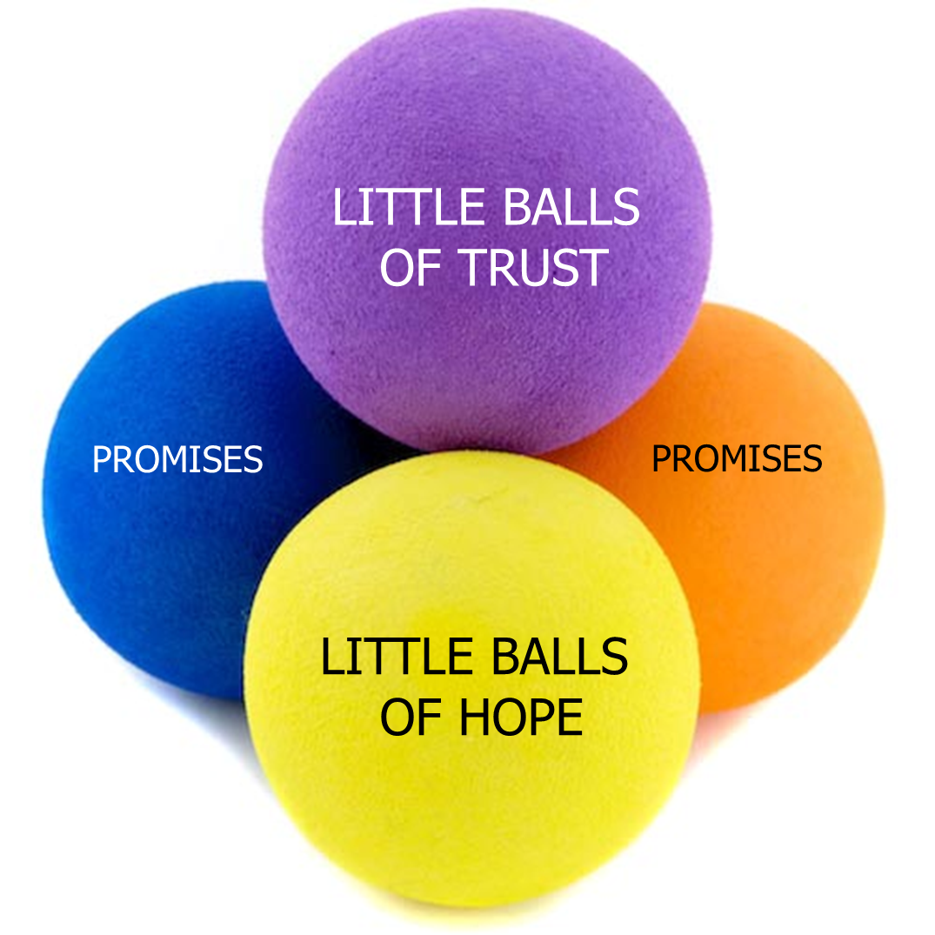
The Wicked World of Managerial Choice
An organisation is a collaborative system which is grounded in trust
‘Trust’ is the great simplifier
‘Trust’ enables the avoidance of the potentially paralyzing complexity of purposive collective endeavour.

Slide 39


THE PARADOX OF TRUST
You have to be mad to trust anyone
BUT
PROMISES AND TRUST
If you do not trust anyone you will go mad
COLLABORATITION

Slide 40
THE PARADOX OF TRUST
You have to be mad to trust anyone
BUT
PROMISES AND TRUST
IN WHOM TO TRUST IS YOUR CHOICE
AND A CHOICE OF IMMENSE IMPORTANCE
If you do not trust anyone you will go mad
COLLABORATITION

Slide 42

The Nature of Managerial Work
promises are inter-subjective;
  they have a ‘who to whom’ character.

Slide 43
INTENTIONS
EXPECTATIONS
PROMISES
Actions arisng
IN THE
SPACE
BETWEEN

Slide 44

The Nature of Managerial Work
No ‘collective’ be it an organization, department, function or government can accept/craft a commission

Slide 45
The Nature of Managerial Work
An individual with a particular hierarchical position has within their ‘power’ the capability of making, shaping & accepting promises on behalf of others

Slide 46
The Nature of Managerial Work
Authority can be seen as the capability of an individual to make, shape & accept promises on behalf of a certain set of individuals.

Slide 47


The Nature of Managerial Work
However, there is only ever a potentiality of a ‘collective’ in the making/shaping/acceptance of such a collective promise, as……..
promises are only ever inter-subjective.

Slide 48
The Nature of Managerial Work
  Only individuals can have intentions,
  Only individuals can make promises
    even though they may do so on behalf of a potential ‘collective’
  Roles, jobs, organizations, functions, departments etc. etc. do not have intentions and cannot make or capture promises

Slide 49

The Nature of Managerial Work
In essence the manager involved is simply promising to engage in the shaping & sustaining of promises with his/her subordinates

Slide 50
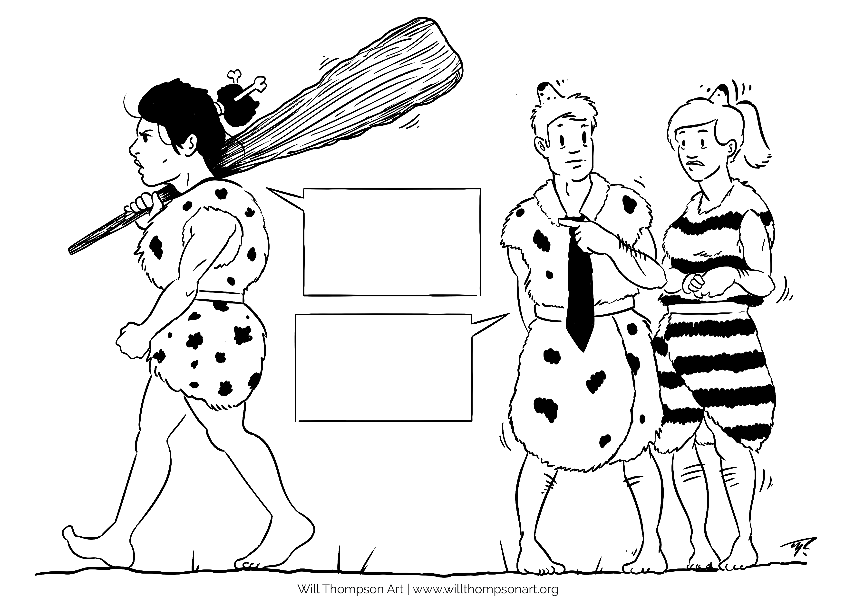
NO
CHANCE!
I’VE AGREED
THAT
WE WILL…
NO PROBLEM BOSS…

Slide 51
Sustaining commissions
Compliance with norms [e.g. authority], procedures and the seeking of continuance may be heavily represented in individual rationales for the acceptance and fulfilling of promises, but the influence of emotional factors is strong:
“ I’m only doing this for you y’know; if it was anybody else I’d...”
In the turbulent situations of the studied managers the authentic & strong-but-flexible commitment to promises generated by such affective rationale proves invaluable.

Slide 52
The Nature of Managerial Work
“Power is the illusion people get when they are obeyed…[they] discover what their power is really made of when they start to lose it. They realise, but too late, that it was ‘made’ of the wills of others” [Latour 1986 p 268]

Slide 53
The Nature of Managerial Work
Numerous studies of managing point up the intensity of the lateral interactions between managers, both in terms of content and frequency.
“ A manager almost never has authority equal to her responsibility; she must depend on the actions of many people over whom he has not the slightest control”
[Sayles 1964 p42]
RESPONSIBITY-AUTHORITY CONGRUENCE

Slide 54
Paradoxes of Organizing
“ New managers learn very soon that formal authority is a very limited source of power. Most of those who can make a manager’s life miserable are people over whom they have no formal authority; that is bosses and peers. Management has just as much to do with negotiating interdependencies as it does with exercising authority…AND the higher your position the more dependent you become…”
[Hill 2003 p262]
RESPONSIBILITY- AUTHORITY CONGRUENCE

Slide 55
The Nature of Managerial Work
Numerous studies of managing point up the intensity of the lateral interactions between managers, both in terms of content and frequency.
“ A manager almost never has authority equal to her responsibility; she must depend on the actions of many people over whom he has not the slightest control”
[Sayles 1964 p42]
RESPONSIBITY-AUTHORITY CONGRUENCE

Slide 56
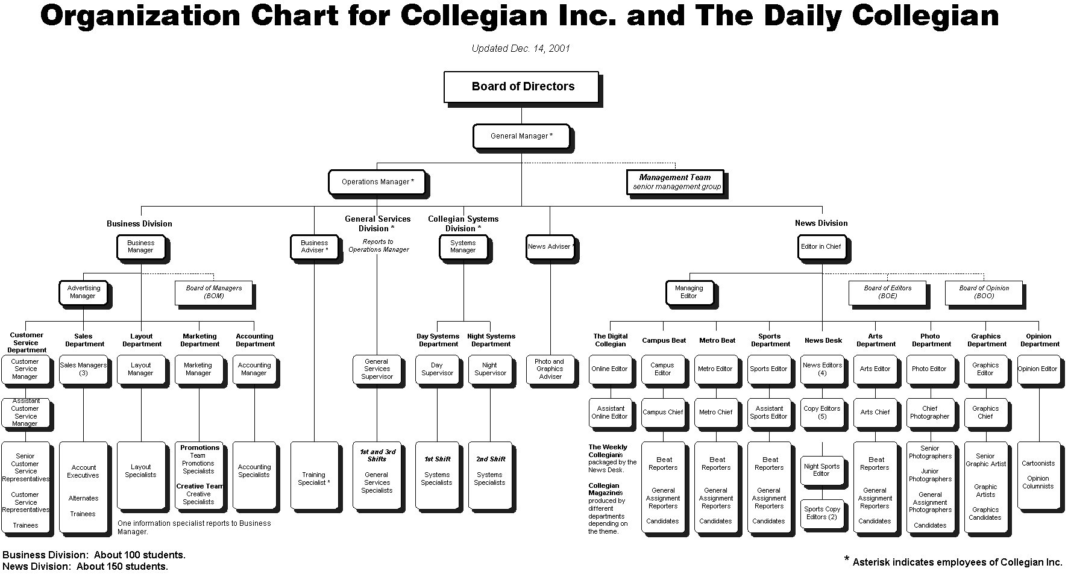
The Nature of Managerial Work
“..tying together the independent parts of the total operation that have been fractionated by the need for specialists, departments, and organizational checks and balances.” [Sayles 1964 p259]

Slide 57
A Paradox of Organizing
‘Organized’ one way, ‘organizing’ the other
‘Organized’ one way, ‘operating’ the other
Hierarchy versus business process
Business – the process of ‘going to market’

Slide 58
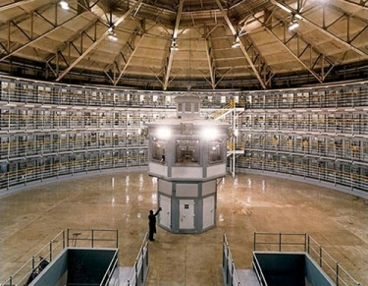
THERE IS NO PANOPTICON

Slide 59
The Nature of Managerial Work
An organisation is a collaborative system which is grounded in trust
‘Trust’ is the great simplifier
‘Trust’ enables the avoidance of the potentially paralyzing complexity of purposive collective endeavour.

Slide 60

What exactly is he saying & what the fog does he mean, why the fog is he saying that, & why now. What the fog is he thinking, and why does he think that; who the fogging hell told him that, and why would he believe it. What the fog does he want out of this. How the fog should I deal with this - what the fog should I say ?
WTF
Twitter Acronym
Managerial Reality
A WICKED WORLD

Slide 61
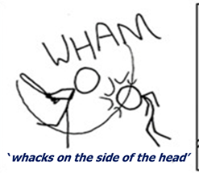
THE PARADOX OF TRUST
You have to be mad to trust anyone
BUT
If you do not trust anyone you will go mad
IN WHOM TO TRUST IS YOUR CHOICE
AND A CHOICE OF IMMENSE IMPORTANCE
JUDGEMENTS ABOUT PEOPLE
YOU MUST MAKE

Slide 62
The Nature of Managerial Work
An organisation is a collaborative system which is grounded in trust
‘Trust’ is the great simplifier
‘Trust’ enables the avoidance of the potentially paralyzing complexity of purposive collective endeavour.

Slide 63

BUT NOT BLIND TRUST!
Promises made
The virtuous circle of promises
Promises fulfilled
Promises shaped
Authentic trust
Building Trust : In Business, Politics, Relationships, and Life
by Fernando Flores, Robert C. Solomon

Slide 64
The Nature of Managerial Work
“ The individual manager does not have a clearly bounded job with neatly defined authorities and responsibilities. Rather s/he is placed in the middle of a system of relationships, out of which s/he must fashion an organization that will accomplish his objectives”
[Sayles 1964 p27]
This complex network of relationships must be shaped and sustained

Slide 65
The Nature of Managerial Work
Promises are the currency of collaboration
The cultivating of relationships underpins the effective shaping and sustaining of promises
‘networking’.. ..[the] developing [of] a network of co-operative relationships to and among those people needed to execute the plan and achieve the objective
All promises are shaped, sustained & fulfilled within relationships
The authentic strong-but-flexible robust promises one needs represent the interest on the social capital one develops.

Slide 66
Relational Coordination*
Authentic Robust promises are the interest on the social capital one accrues
1430-
Relationships shape the communication
through which collaboration occurs
*MY VERSION OF Jody Hoffer Gittell - Transforming Relationships for High Performance

Slide 67
Relational Coordination*
Authentic Robust promises are the interest on social capital accrued
Shared Purpose with one’s collaborators
Understanding of one’s collaborators – contribution & knowledge
Valuing one’s collaborators – contribution & knowledge
Communication that is -
Frequent
Timely
Accurate
Problem-solving
*MY VERSION OF Jody Hoffer Gittell - Transforming Relationships for High Performance

Slide 68
Relational Coordination*
Authentic Robust promises are the interest on social capital accrued
Not/weakly shared Purpose with one’s collaborators – ‘silo-mentality’
Not/weakly understanding of one’s collaborators – contribution & knowledge
Not/weakly valuing one’s collaborators – contribution & knowledge
Communication that is -
Infrequent
Delayed
Inaccurate
Finger-pointing/Blaming
*MY VERSION OF Jody Hoffer Gittell - Transforming Relationships for High Performance

Slide 69
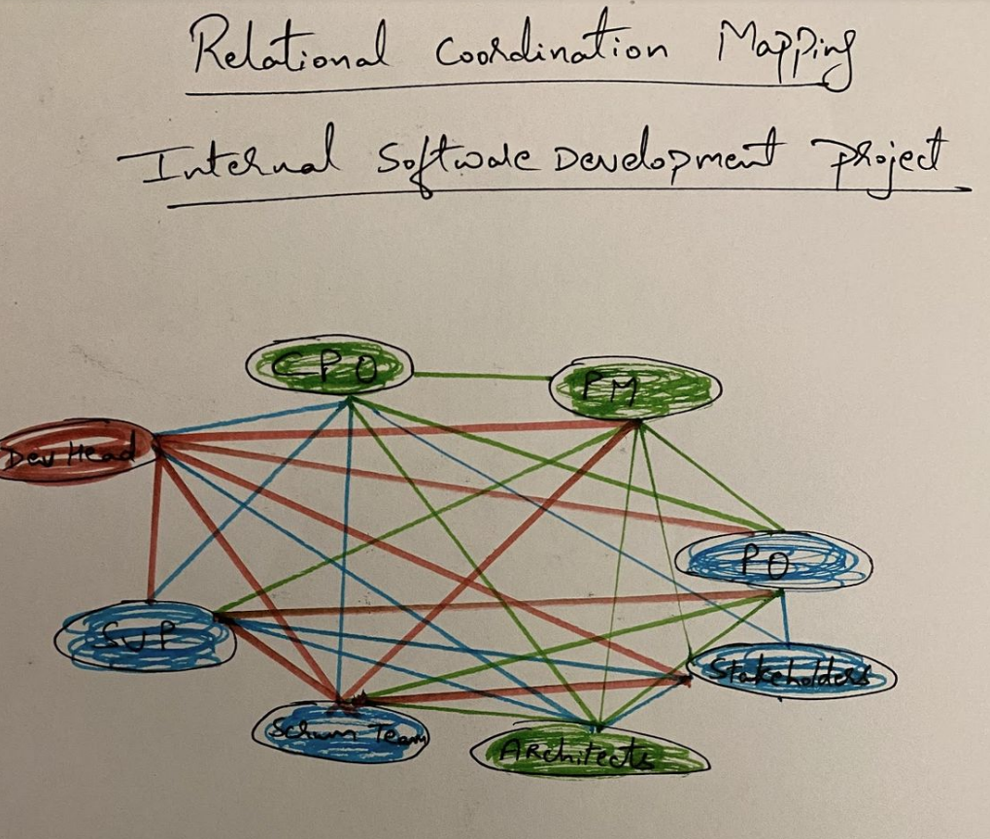
BREAKOUT WORK ON RC
ACTIVITY 1 – 15 minutes
For an important work process in which you are heavily involved carefully and comprehensively identify and note down all the roles/functions involved and then..
Draw a diagram like this one ………………….
    Green lines for strong connection
    Blue lines for moderate connection
    Red Lines for poor connection
  There should be pens and paper on the table
See activity sheet

Slide 70

Communication that is -
Frequent
Timely
Accurate
Problem-solving
INDICATES GOOD RELATIONAL CONNECTION
Communication that is -
Infrequent
Delayed
Inaccurate
Finger-pointing/Blaming
INDICATES POOR RELATIONAL CONNECTION

Slide 71
Shared Purpose with one’s collaborators
Understanding of one’s collaborators – contribution & knowledge
Valuing one’s collaborators – contribution & knowledge
GOOD RELATIONAL CONNECTION
Not/weakly shared Purpose with one’s collaborators – ‘silo-mentality’
Not/weakly understanding of one’s collaborators – contribution & knowledge
Not/weakly valuing one’s collaborators – contribution & knowledge
POOR RELATIONAL CONNECTION

Slide 72
BREAKOUT WORK ON RC
ACTIVITY 2 – 10 minutes
For this important work process in which you are heavily involved carefully and comprehensively identify and note down all the ‘key’ people involved and then..
Draw a diagram like this one with you at the centre…..
    Green lines for strong relationships
    Blue lines for moderate relationships
    Red Lines for poor relationships
  There should be pens and paper on the table
Joe
-sales
Linda
- accounts
??
ME
??
Rebecca
- marketing
??
??
??

Slide 73
BREAKOUT WORK ON RC
ACTIVITY 3 – 10 minutes
For your focal project carefully identify and note down all the ‘key’ people involved and then..
Draw a diagram like this one with you at the centre…..
    Green lines for good relationships
    Blue lines for reasonable relationships
    Red Lines for poor relationships
  There should be pens and paper on the table
Joe
-sales
Linda
- accounts
??
ME
??
Rebecca
- marketing
??
??
??

Slide 74
BREAKOUT WORK ON RC
IN TRIOS/QUARTETS – 15 MINUTES
WHAT INDICATES A ‘GOOD’ RELATIONSHIP
  5 BULLET POINTS TO SHARE WITH THE CLASS
HOW DO WE GET A ‘GOOD’ RELATIONSHIP
  5 BULLET POINTS TO SHARE WITH THE CLASS
SHARING SESSION
WITH COFFEE

Slide 75
Relational Coordination*
Authentic Robust promises are the interest on social capital accrued
Shared Purpose with one’s collaborators
Understanding of one’s collaborators – contribution & knowledge
Valuing one’s collaborators – contribution & knowledge
GOOD
RELATIONSHIPS
Communication that is -
Frequent
Timely
Accurate
Problem-solving

Slide 76
Relational Coordination*
Authentic Robust promises are the interest on social capital accrued
Shared Purpose with one’s collaborators
Understanding of one’s collaborators – contribution & knowledge
Valuing one’s collaborators – contribution & knowledge
GOOD
RELATIONSHIPS
Communication that is -
Frequent
Timely
Accurate
Problem-solving

Slide 77
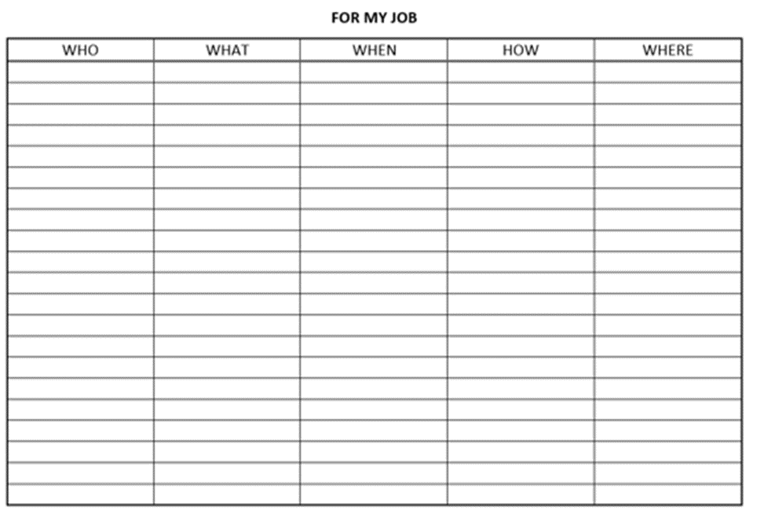
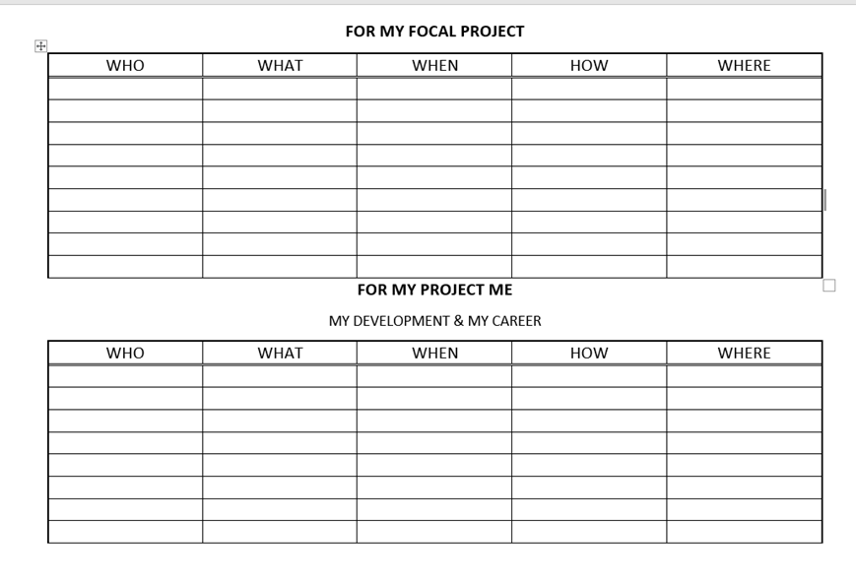
MY RELATIONSHIP DEVELOPMENT PLANS
BREAKOUT WORK ON RC
30 MINUTES
WITH COFFEE

Slide 78
The Nature of Managerial Work
1530-1630
Lenney talk and class discussion
Relationship building– perspectives
  - necessary reflexivity - – striving for enlarged mentality
  Curiosity - Interest
Melding purposes & melding perspectives [prejudices]
Shaping & sustaining promises
Robust promises – spirit of a promise is its purpose
- purpose of the purpose

Slide 79
The Nature of Managerial Work
Promises are the currency of collaboration
The cultivating of relationships underpins the effective shaping and sustaining of promises
‘networking’.. ..[the] developing [of] a network of co-operative relationships to and among those people needed to execute the plan and achieve the objective
All promises are shaped, sustained & fulfilled within relationships
The authentic strong-but-flexible robust promises one needs represent the interest on the social capital one develops.

Slide 80
Authentic Robust promises are the interest on social capital accrued
Shared Purpose with one’s collaborators
Understanding of one’s collaborators – contribution & knowledge
Valuing one’s collaborators – contribution & knowledge
GOOD
RELATIONSHIPS
Communication that is -
Frequent
Timely
Accurate
Problem-solving

Slide 81
The Nature of Managerial Work
An organisation is a collaborative system which is grounded in trust
‘Trust’ is the great simplifier
‘Trust’ enables the avoidance of the potentially paralyzing complexity of purposive collective endeavour.

Slide 82
BUT NOT BLIND TRUST!
Promises made
The virtuous circle of promises
Promises fulfilled
Promises shaped
Authentic trust
Building Trust : In Business, Politics, Relationships, and Life
by Fernando Flores, Robert C. Solomon

