Slide 1
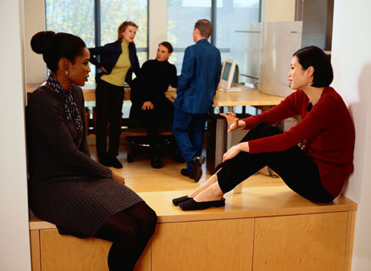
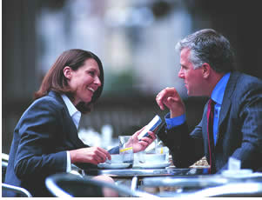
Marketing Managerial Work
A multitude of studies have pointed out that marketing managers spend the vast majority of their time talking, and, more often than not it would appear, talking to other managers within their own firm:
“Managers talk and listen most of the time”
[Stewart 1983 p87]

Slide 2
Marketing Managerial Work
“ However automated the work or standardised the procedures, people bring organizations to life. What people do - up and down the hallways and up and down the organizational structure, all day long, is talk..” [Boden 1994 p23]

Slide 3
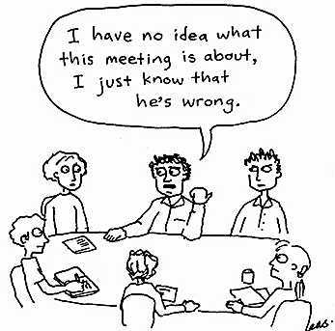

Marketing Managerial Work
What is all this talk
about??????????

Slide 4
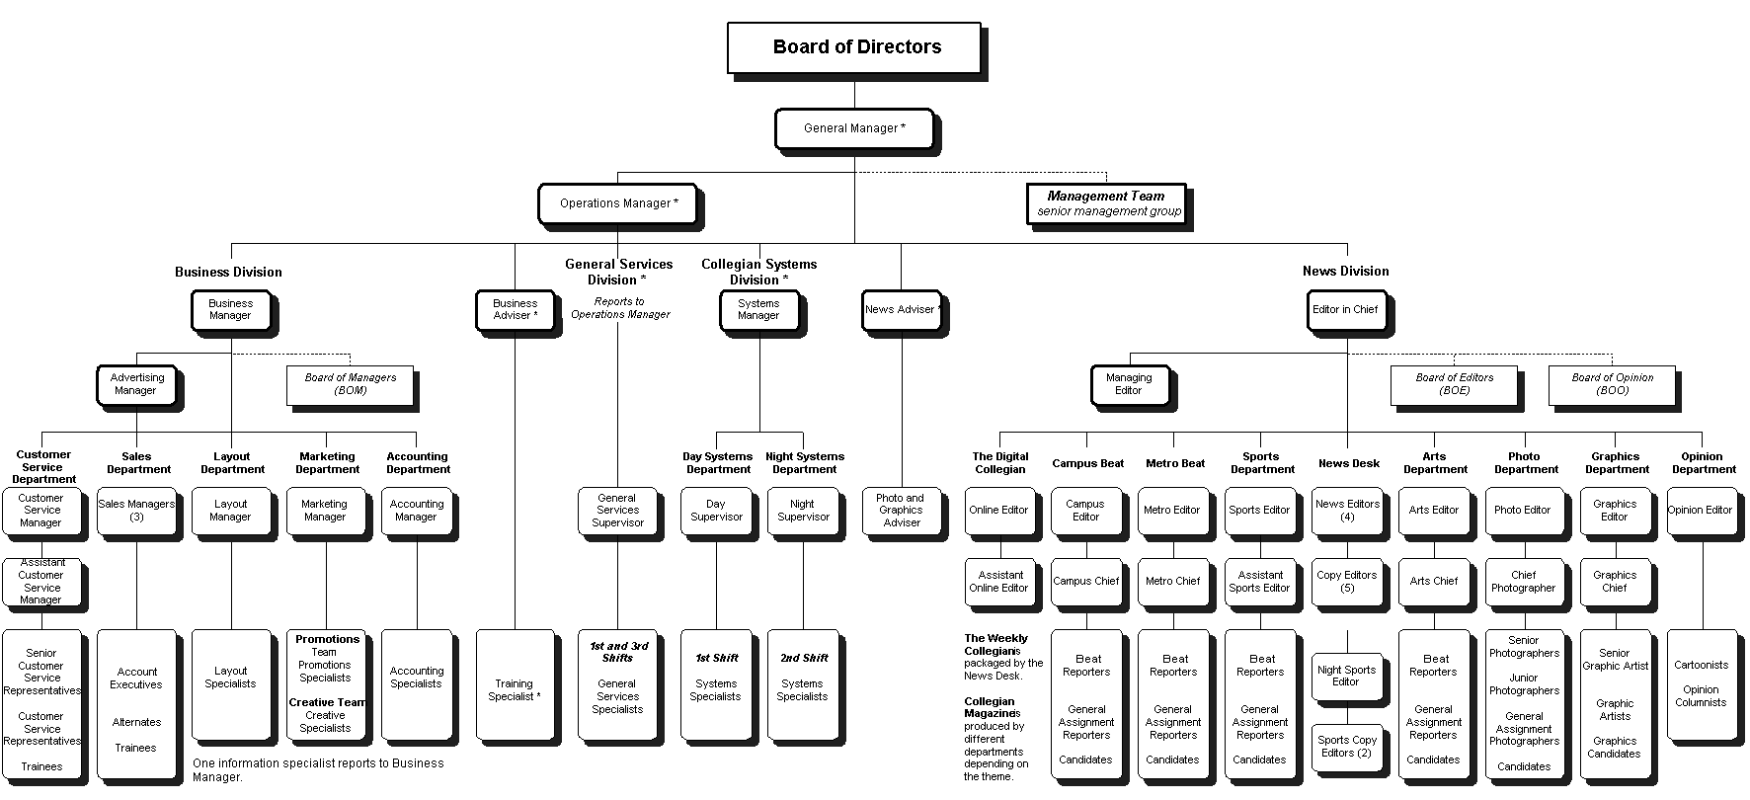
The Nature of Managerial Work
However the torrent of talk appears, in the main, to represent the everyday practical work of CO-ACTION; of the ‘working-through’ of the differentiation-integration dilemma

Slide 5
Marketing Managerial Work
‘Organized’ one way, ‘organizing’ the other
‘Organized’ one way, ‘operating’ the other
Hierarchy versus business process
Business – the process of ‘going to market’

Slide 6
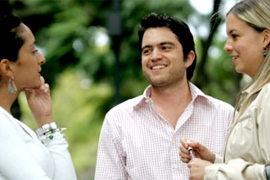

Marketing Managerial Work
“..the ability for coherent organizing to occur depends upon ‘the myriad of loosely coupled micro-conversations going on endlessly every day’ “
[Dunford & Palmer 1998 p218]

Slide 7
The Nature of Managerial Work
Peeling the Managerial Onion
- need to look beyond the ‘skin’ of managerial conduct

Slide 8
Peeling the Managerial Onion
The underlying coherence of the myriad, seemingly unrelated, activities of phone calls, coffee machine conversations, emails…………………
CONDUCT
THE SUBSTANCE
OF CONDUCT
SURVIVAL
&
PROSPERITY
The purpose of the torrent of talk
BEHAVIOUR & ACTIVITY

Slide 9
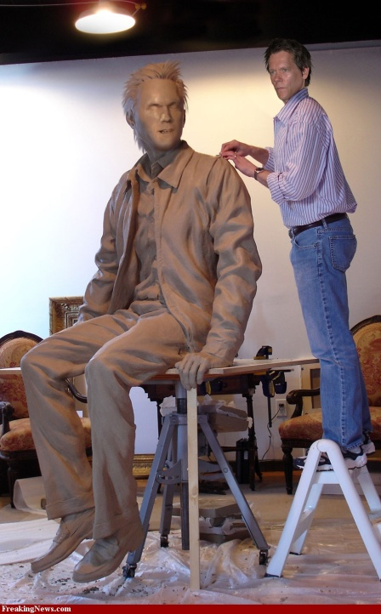
The visible ‘skin’ of the behaviour/activity of sculptors and masons , their conduct, is identical but……

Slide 10
Peeling the Managerial Onion
The purpose of the torrent of talk
CONDUCT
THE SUBSTANCE
OF CONDUCT
SURVIVAL
&
PROSPERITY
BEHAVIOUR & ACTIVITY

Slide 11
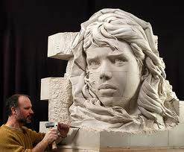
The Mindful Marketer
A sculpture is crafted from the rock by the moment by moment chiselling
Business & organization is crafted through the moment by moment interaction of people

Slide 12
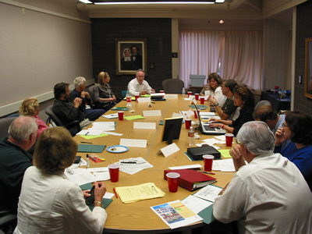
The Mindful Marketer
No matter the grand designs, structures and aspirations all of that that emerges is a product of the moment by moment conduct of the people of the organization
The moment by moment ‘managing’ crafts and re-crafts the business every day
Right Thought, Right Talk, Right Action

Slide 13
The Nature of Managerial Work
We contend that the essence of managerial work, the very substance of a manager’s conduct, is the process of shaping and sustaining commissions

Slide 14

The Nature of Managerial Work
In the terms of the model:
  ‘Organizing’ is conceptualised as the process of shaping & sustaining commissions

Slide 15
Managerial Work
ORGANIZING

Slide 16
Managerial Work
SHAPING AND SUSTAINING
COMMISSIONS

Slide 17
Managerial Work
COMMISSIONING

Slide 18
The Nature of Managerial Work
But where are the ‘decisions’ & decision making in all of this you might well ask?
Surely this is the substance?

Slide 19
The Nature of Managerial Work
The term ‘decision’ is simply how we label the transition from the ‘shaping’ to the ‘sustaining’ of commissions
SHAPING COMMISSIONS
SUSTAINING COMMISSIONS

Slide 20
The Nature of Managerial Work
The very substance of a manager’s conduct is the process of shaping and sustaining commissions
But what are commissions?

Slide 21
The Nature of Managerial Work
commissions are the whole ‘point’ of managerial conduct
commissions are the ‘business of the talk’

Slide 22
The Nature of Managerial Work
commissions are the objective-laden seeds of action.
  a pledge to do something in the future

Slide 23
The Nature of Managerial Work
commissions are
  Undertakings through which someone agrees / accedes to endeavour to do, or forbears to do, ‘something’

Slide 24
A commission in the making
“So...what they’ve said to me is that if we put it up to twenty sites they’ll strengthen the [F] branding...so.. can you work with [A] today and get back to me with a cost...it’ll have to come out of your [Z] budget though! ”

Slide 25
A commission in the making
“..what will really annoy me ..is that the same will happen with this unless I get a commitment from Paul, that before the orders are put up, that he lets me know so I can.....”

Slide 26
A commission in the making
“..on [Customer A] are we spending or aren’t we..on [Customer B] I’ve said don’t spend any money.... these are the ones we’re gonna invest in..yeah....and these are where we’re not gonna spend money”

Slide 27
A Mindful Marketer understands that….
commissions are the ‘currency’ of collaboration
commissions are the links in the means-ends chain

Slide 28
Means-Ends - The Cone of commissions
‘Firm-Level’ goals decompose into
a complex cascade of sub goals, many of which are interdependent.
$

Slide 29
Means-Ends - The Cone of commissions
‘Firm-Level’ goals
‘Firm-Level’ goals
decompose into a complex cascade of sub-goals, many of which are interdependent.
are instantiated in the managerial commissions made and fulfilled
$
The Organizational Space

Slide 30
Means-Ends - The Cone of commissions
Super-ordinate goals
Decompose into a complex cascade of sub-goals, many of which are interdependent.
$
Are instantiated in the managerial commissions made and fulfilled
Organizational Space
Extra-organizational Space

Slide 31
Means-Ends - The Cone of commissions
Super-ordinate commissions
Decompose into a complex cascade of sub-commisions, many of which are interdependent.
$
Organizational Space
Extra-organizational Space

Slide 32
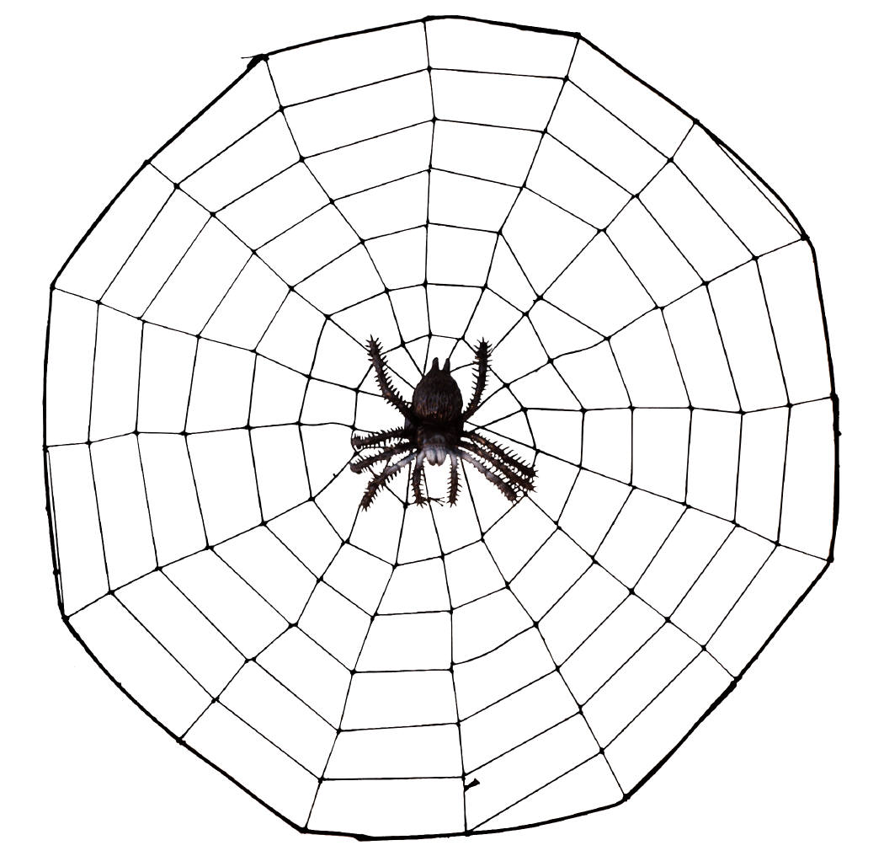
The Nature of Managerial Work
  Plans/strategies can be seen as ever-evolving webs of commissions
  ..and….

Slide 33
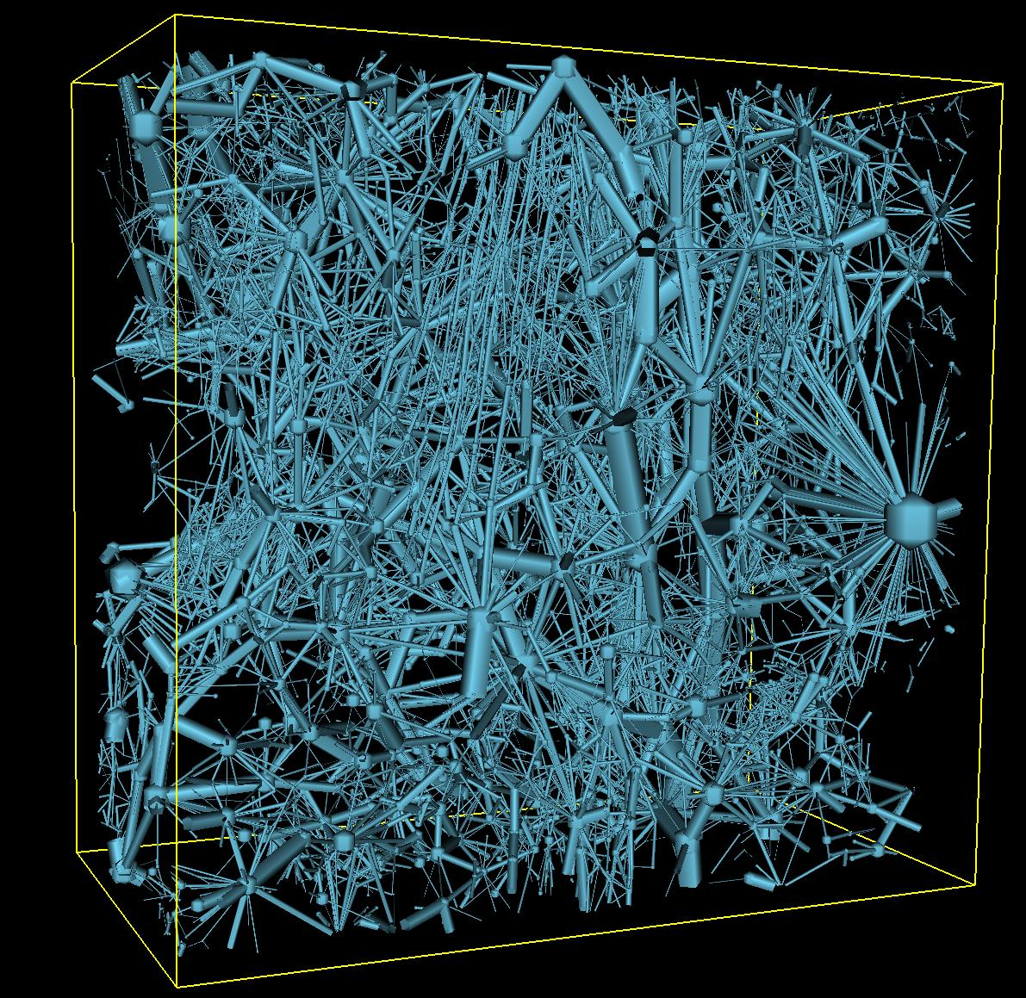
  Organizations as
  ever-evolving
  networks of commissions
  -a web of webs
  -a nexus of projects
c
c
c

Slide 35
The Nature of Managerial Work
commissions are
  Undertakings through which someone agrees / accedes to endeavour to do, or forbears to do, ‘something’

Slide 36
A Mindful Marketer understands that….
commissions are the ‘currency’ of collaboration
commissions are the links in the means-ends chain

Slide 37
Organization – networks of commissions
commissions
C4
C6
C2
C3
C8
C1
C5
C7
C9
C10

Slide 38
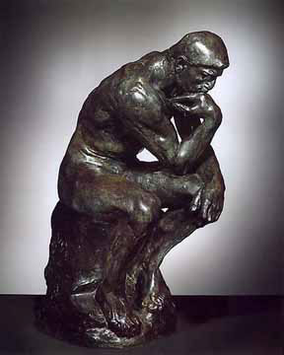
The Nature of Managerial Work
commissions are fundamentally social
  They are inter-cognitive
Intentions intra-cognitive.

Slide 39

The Nature of Managerial Work
Expectations are the flipside of commissions.
commissions generate expectations

Slide 40
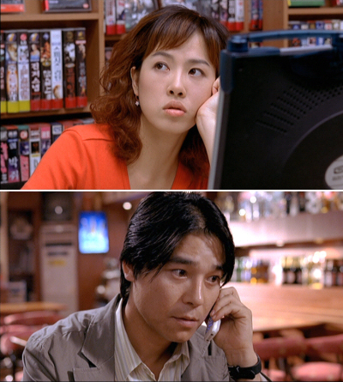
The Nature of Managerial Work
  Expectations represent the vital assumptions with regard to one’s collaborator’s projected actions that underpin collective endeavour.

Slide 41
The Nature of Managerial Work
INTENTIONS
COMMISSIONS
EXPECTATIONS
INTRA-SUBJECTIVE
INTER-SUBJECTIVE
INTRA-SUBJECTIVE

Slide 42
Organization
individuals
commissions
P5
P6
P9
P6
P8
P1
P5
P6
P11
C10

Slide 43
The Nature of Managerial Work
INTENTIONS
COMMISSIONS
EXPECTATIONS
INTRA-SUBJECTIVE
INTER-SUBJECTIVE
INTRA-SUBJECTIVE

Slide 44

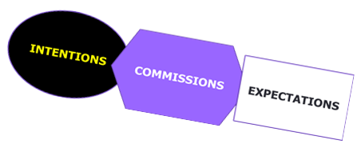
Organization
individuals
commissions
P5
P6
P9
P6
P8
P1
P5
P6
P11
C10

Slide 45
INTENTIONS
EXPECTATIONS
COMMISSIONS
Actions arisng
IN THE
SPACE
BETWEEN

Slide 46

The Nature of Managerial Work
commissions are inter-subjective;
  they have a ‘who to whom’ character.

Slide 47

The Nature of Managerial Work
No ‘collective’ be it an organization, department, function or government can accept/craft a commission

Slide 48
The Nature of Managerial Work
An individual with a particular hierarchical position has within their ‘power’ the capability of crafting & accepting commissions on behalf of others

Slide 49
The Nature of Managerial Work
Authority can be seen as the capability of an individual to craft & accept commissions on behalf of a certain set of individuals.

Slide 50


The Nature of Managerial Work
However, there is only ever a potentiality of a ‘collective’ in the crafting/acceptance of such a collective commission, as……..
commissions are only ever inter-subjective.

Slide 51
The Nature of Managerial Work
  Only individuals can have intentions,
  Only individuals can make commissions
    even though they may do so on behalf of a potential ‘collective’
  Roles, jobs, organizations, functions, departments etc. etc. do not have intentions and cannot make or capture commissions

Slide 52

The Nature of Managerial Work
In essence the manager involved is simply accepting a commission to engage in the Shaping & Sustaining of commissions with his/her subordinates

Slide 53
The Nature of Managerial Work
“Power is the illusion people get when they are obeyed…[they] discover what their power is really made of when they start to lose it. They realise, but too late, that it was ‘made’ of the wills of others” [Latour 1986 p 268]

Slide 54

The Nature of Managerial Work
A commission made by or on behalf of an incipient collective is intrinsically precarious
Even if it was authentic
As it requires the Shaping & Sustaining of commissions

Slide 55

The Nature of Managerial Work
As we all know from often bitter experience, an individual’s intentions may not necessarily be congruent or consistent with their manifest commissions.
  ‘Authenticity’ is hence a much sought characteristic of commissions.

Slide 56
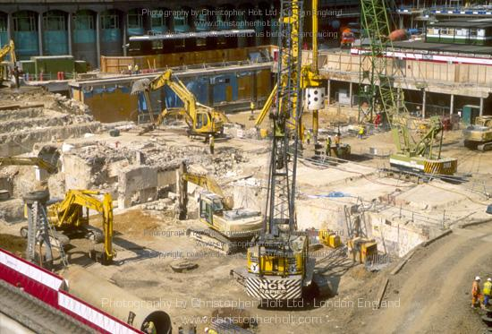
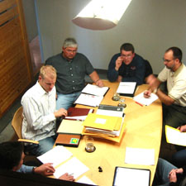
The Nature of Managerial Work
commissions hold the promise of ‘future directed intentions’
By definition their capture and fulfilment are not synchronous

Slide 57
The Nature of Managerial Work
An organisation is a collaborative system which is grounded in trust
‘Trust’ is the great simplifier
‘Trust’ enables the avoidance of the potentially paralyzing complexity of purposive collective endeavour.

Slide 58
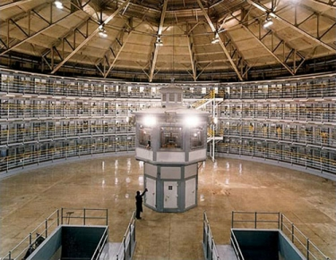
THERE IS NO PANOPTICON

Slide 59

LITTLE BALLS
OF TRUST
COMMISSIONS
COMMISSIONS
LITTLE BALLS
OF HOPE

Slide 60

TRUST
You have to be mad to trust anyone

Slide 61
TRUST
You have to be mad to trust anyone
If you do not trust anyone you will go mad

Slide 62
The Nature of Managerial Work
An organisation is a collaborative system which is grounded in trust
‘Trust’ is the great simplifier
‘Trust’ enables the avoidance of the potentially paralyzing complexity of purposive collective endeavour.
BUT WHAT FORM OF TRUST?

Slide 64

The Dimensions of commissions
What, Who, When and How represent the four central dimensions in which commissions are specified.

Slide 65
The Dimensions of commissions
The ‘what’ refers to the ‘content’ of a commission
  e.g. ‘we’ll take the retailers logo off the ‘available-at’ tag that’s been put on the ‘Zest’ Adshel poster’
The ‘how’ of a commission refers to its mode of fulfilment
  e.g. ‘I’ll talk to the customer tonight and the agency first thing tomorrow’.

Slide 66


The Dimensions of commissions
The ‘when’ dimension in a sense demands no further elaboration
Except to stress that it is a fundamental characteristic of commissions that their capture and acceptance are temporally, and most often spatially, dislocated from their fulfilment or dissolution.

Slide 67

The Dimensions of commissions
The ‘who’ dimension is only at first sight simple.

Slide 68
The Nature of Managerial Work
  Only individuals can make commissions
    even though they may do so on behalf of a potential ‘collective’
  Roles, jobs, organizations, functions, departments etc. etc. do not have intentions and cannot make or capture commissions

Slide 69
The Dimensions of commissions
“When I was in H.Q. the rumour was that [Global Chief Marketing Officer] was going to resign... came back.... having convinced people in H.Q. that it was the right thing to do... everyone convinced about that ...then the C.M.O. resigned, and his number two! So people here started to get nervous... so we are in this state.. need to get the brand hot; we've got [X media-event sponsorship].. need to put in [Y] million dollars to deliver it, and now in a position don't know if I've got the money... global had committed to some money.. nobody more senior than me will make any decision now ‘cause they're all so nervous”

Slide 70

The Dimensions of commissions
The frequency and rapidity of organizational change often make ‘the who’ highly problematic, with carefully crafted webs of commissions rapidly disintegrating when key personnel ‘move on, up, or out’

Slide 72

Forms of commissions
  The following forms of commission dominate:

Slide 73
Forms of commissions
  commissions to allocate resources
    Financial
      e.g. ‘Zeb OK!!..we’ll buy it’
    Human
      e.g.‘ I’ll put Stewart on the delivery failures full time’
    Priorities / sequencing
      e.g. ‘Tony, let’s kill this off first eh?”
    Attention
      e.g. ‘we will need to watch the numbers carefully’

Slide 74
Forms of commissions
commissions to:
  Execute a physical act
    e.g. ‘Come on Martin, just sign the contract’
  Execute a cognitive act
    e.g. ‘I’ll think about it and get back to you’
  Exhibit a certain behaviour
    e.g.‘not quite the way we see it, but we’ll support you at the board meeting’

Slide 75

Forms of commissions
  Endeavour to achieve a projected outcome
    e.g. ‘We’ll do whatever it takes to get the product there”

Slide 76
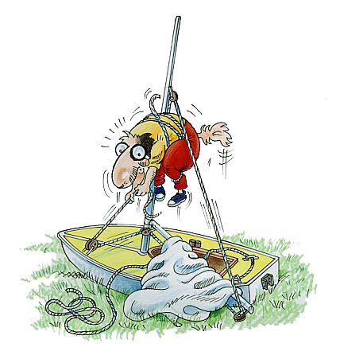
Forms of commissions
In essence all forms of commission are of the latter form as they all represent commissions to endeavour/try to take action of a certain form.

Slide 77
Forms of commissions
  Engage in the shaping and sustaining of commissions
    e.g. ‘ no problem…I’ll get John to talk to operations and get a plan together’
  That is to engage in ‘MANAGING’
    AS ‘MANAGING’ IS THE SHAPING AND SUSTAINING OF COMMISSIONS..????

Slide 79


Properties of commissions

Slide 80
Properties of commissions
“People regularly make requests and promises, set deadlines, show evidence of completion...but seldom set clear conditions of satisfaction, insist on accountability for fulfilling these conditions, or communicate straightforwardly to renegotiate the performance agreement” [Ford & Ford 1995 p550].
Most commissions are therefore intrinsically underdetermined.
commissions almost inevitably suffer from what might be termed ‘looseness’

Slide 81
Joe: You know we’ve missed it!?
Katie: But we knew about that..how the hell!?
Joe: Yeah, we knew about it, but we didn’t get to know when they were placing the actual order, which is what I was waiting for...’cause there were loads of amendments and changes to make..didn’t you know that?
Katie: No I didn’t but...
Joe: Well it was almost a total re-design we had to do..but anyway I’d spoken to the purchasing and commercial guys about it back then..told them I needed to know when the order was getting placed OK...so I could put up the amended customer orders against it before....then wham!.. saw Chris last Thursday..said hey thought you’d let me know when the order had been put up..told me it had been done..and that it had been bought!!
Katie: So we can’t.....?
Joe: No!.. but I didn’t think what we were doing was right anyway!
Katie: What!!???

Slide 82
Properties of commissions
‘Looseness’ is a fundamental property of commissions as it is rare, no matter the effort expended, that their constituent task(s) cannot be comprehensively or rigorously specified in all their dimensions,
“..like the proverbial manual for riding a bicycle, an action plan can never be entirely spelled out, because there is always another level of operational specificity”
[Isenberg 1986 p259].

Slide 83
The Nature of Managerial Work
Determining the meaning of ‘commission descriptions’ in specific situations is an important component of managerial conduct.
Polysomic
Interpretations

Slide 84

Properties of commissions
Very often commissions ‘pass through many hands’ on route to their fulfilment
commissions therefore often mutate [are transformed] on route to their fulfilment…
  even if the commission context is stable
Mutability
Looseness
+
Polysomicity

Slide 85
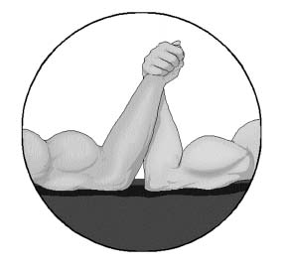
Properties of commissions
commissions are accepted with differing degrees of commitment:
“...just fed up of people agreeing then doing exactly the opposite...I’m gonna get some kind of electrocution system.....”
commissions possess differing ‘strength’.

Slide 86
The Nature of Managerial Work
As we all know from often bitter experience, an individual’s intentions may not necessarily be congruent or consistent with their manifest commissions.
  ‘Authenticity’ is hence a much sought characteristic of commissions.

Slide 87
Properties of commissions
“...just fed up of people agreeing then doing exactly the opposite...I’m gonna get some kind of electrocution system.....”
one seeks strong authentic commissions..and even then…..

Slide 88
Properties of commissions
commissions also lack ‘durability’
“ ..we actually put our bid in for [T]...and got it over [Competitor A]...now in a state where we’ve got it, but I’m sat here thinking should we have it...’cause not sure people support it now”
“Activity was due to start middle of July, that’s what we’d told the retailers,... but then there was feedback from the factory...there was problems..wouldn’t hit… ‘til end July...all the media had been booked so...”
“..the budget we set out with,.. for the [D].., they’re saying they now can’t work to that budget”

Slide 89
Properties of commissions
The accidental, or deliberately malicious, lack of fulfilment of commissions does contribute to the vulnerability of collective endeavour
However………

Slide 90
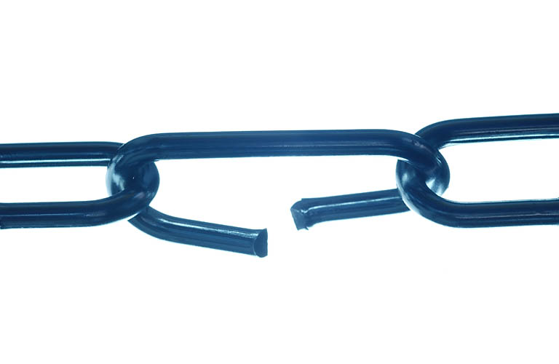
Properties of commissions
Most of the commission lability that managers face derives from:
  ‘changes of mind’,
  ‘changes of situation’,
  ‘unexpected outcomes’ and
  unintended consequences inherent in the turbulent ‘wicked milieu’ managers inhabit.

Slide 91


Properties of commissions
commissions given their predominant forms, their prevalent ‘looseness’, mutation, lability and differing strength are, as a result, inherently precarious
even when authentic!

Slide 92
Properties of commissions
“.. in most realistic scenarios agents are situated in time-varying contexts – the external world may change, another agent may attempt to interact with it, and so on. Therefore in many cases an agent’s beliefs will alter between the making of a commission and it actually performing the associated processing – in fact the longer the time between these 2 events the greater the likelihood of change occurring….commissions may need to be reviewed. Commissions should therefore be relatively stable over time (otherwise there is little point making them) but they should not be irrevocable”

Slide 93

The Nature of Managerial Work
The poor durability of commissions appears at first sight to be a wholly negative attribute of commissions. However………
The inherent unreliability of commissions is clearly the reverse-side of the prized attributes of flexibility and responsiveness

Slide 94
The Nature of Managerial Work
The ‘price’ of the flexibility and responsiveness that the turbulent commercial milieu demands is the inherent unreliability of the crafted webs of commissions.
commission unreliability is the norm and the flip-side of their strength – their ‘responsive modulatability’.

Slide 95
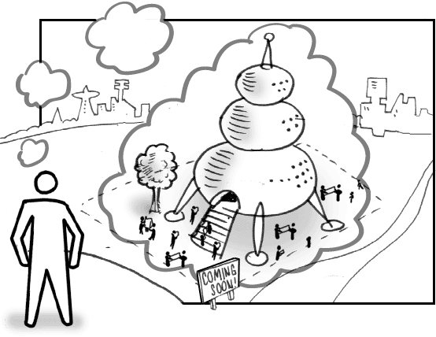
The Nature of Managerial Work
The OBJECTIVE embedded in a commission represents its SPIRIT
Objective-laden seeds of action

Slide 96

The Nature of Managerial Work
Given the turbulence, indeterminacy and complexity of the intra and inter-organizational milieu it is in the ‘spirit’ of their commissions, not in their detail, that managers need their collaborators and customers to act.

Slide 97
The Nature of Managerial Work
The most ‘reliable’ of commissions are quite possibly those where the spirit of a commission is at the centre of its capture/acceptance/fulfillment and where its specification is detailed enough to enable coordination but soft enough to enable flexibility.
These we have come to term:
  ‘robust commissions’.

Slide 98
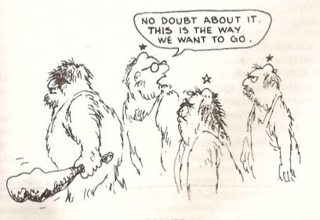
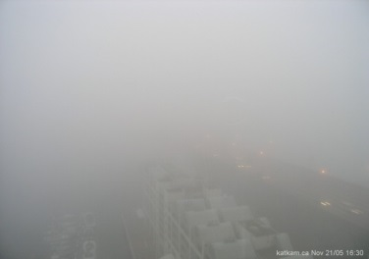
Becoming a Mindful Marketer
AUTHENTIC
ROBUST
COMMISSIONS

Slide 99
Becoming a Mindful Marketer
QUALITY
CONCORDANCING

Slide 100
Becoming a Mindful Marketer
IN THE PUSUIT OF AUTHENTIC
ROBUST COMMISSIONS
QUALITY DELIBERATIVE
CONDUCT IS CRUCIAL

Slide 101
Becoming a Mindful Marketer
AUTHENTIC
ROBUST
COMMISSIONS
Strong?

Slide 102
Becoming a Mindful Marketer
TRUST

Slide 103
The Mindful Marketer
No matter the grand designs, structures and aspirations all of that that emerges is a product of the moment by moment conduct of the people of the organization
The moment by moment ‘managing’ crafts and re-crafts the business every day
Right Thought, Right Talk, Right Action

Slide 104
The Mindful Marketer
No matter the grand designs, structures and aspirations all of that that emerges is a product of the moment by moment conduct of the people of the organization
The moment by moment ‘managing’ crafts and re-crafts the business every day
Right Thought, Right Talk, Right Action

Slide 106
A Model of Managerial Work
The Substance of Managerial Conduct

Slide 107
The Mindful Manager
COMMISSIONING

Slide 108
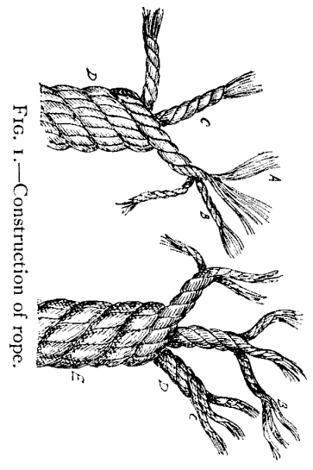
A Model of Managerial Work
Our Substance of Conduct model can be likened to a rope
The strands and threads of the rope represent the processes in which managers are engaged
Time

Slide 109
The Model of Managerial Work
These processes become ‘visible’ when a manager engages in them
Just as the strands and threads of a rope become visible as they surface repeatedly over its length.
Time

Slide 110
The Nature of Managerial Work
A cross-section of this ‘Rope of Conduct’
Time

Slide 111
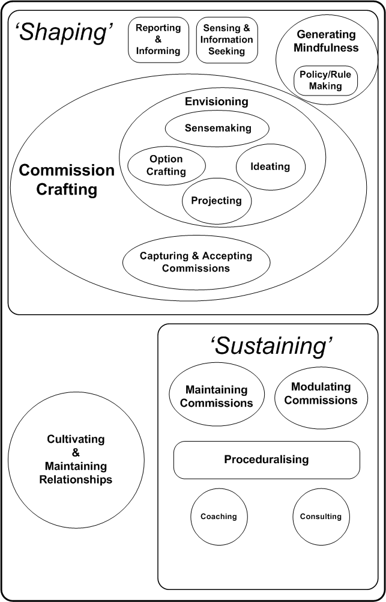
A Cross section of the Rope of Conduct

Slide 112
The Nature of Managerial Work
It must be stressed that managers ‘hop’ between ‘threads of conduct’ in as seamless a manner as they ‘hop’ between subjects/topics, and at often much greater speed, and with far greater frequency.
The separateness of the strands and threads should not be taken to mean that there exists a clear separation of the strands and threads of conduct.

Slide 113
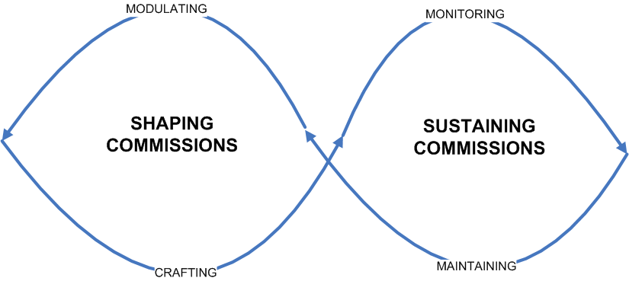

Slide 114
Shaping commissions

Slide 115
Shaping commissions

Slide 116
Shaping commissions
Strategizing

Slide 117
STRATEGY FORMULATION
CRAFTING COMMISSIONS
STRATEGY IMPLEMENTATION
SUSTAINING COMMISSIONS

Slide 118
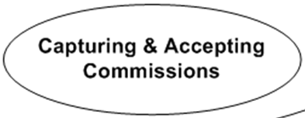
STRATEGY FORMULATION
CRAFTING COMMISSIONS
STRATEGY IMPLEMENTATION
SUSTAINING COMMISSIONS

Slide 119
STRATEGY FORMULATION
?Authenticity – Robustness?
CRAFTING COMMISSIONS
STRATEGY IMPLEMENTATION
SUSTAINING COMMISSIONS

Slide 120
The Nature of Managerial Work
Crafting commissions

Slide 121
Strategizing
Social Construction
of ‘Alternaties’,
Alternatives &
Futurities
Cognitive
conduct
Deliberative
conduct

Slide 122
Shaping commissions
Managers are the contract labour in the social construction of ‘alternaties’, alternatives & futurities and it is on these foundations that commissions are founded and commission webs are built.

Slide 123
Shaping commissions
Strategizing

Slide 124
Shaping commissions
Managers TALK to craft the degree of cognitive concordance as to
  ‘what is’,
  ‘why what is, is’
  what should be, and
  how that ‘what’ should be achieved
that they perceive as necessary for their collective action
Their CO-ACTION

Slide 125
The Marketing Manager
Marketers deliberate to craft the degree of cognitive concordance as to
  ‘what is’,
  ‘why what is, is’
  what should be, and
  how to get from A to Z!!
that they perceive as necessary for their shaping of commissions/webs of commissions

Slide 126
Shaping commissions
The essence of deliberative output is concordance as to the ‘why’. Or not, as the case may be:
“we’re being very tactical...there’s lots of different points of view across the business...’n were not all going in the same direction”
ROBUST COMMISSIONS
SPIRIT

Slide 127
Shaping commissions

Slide 128
Shaping commissions
“..leadership is concerned with the transformation of doubts into the psychological grounds of cooperative action” [Long 1963]
“..leadership involves the social construction of the context that both legitimates a particular form of action and constitutes the world in the process”
[Grint 2005 p1471]
Sensemaking =
ALTERNITY CONSTRUCTION

Slide 129
Sensemaking
Social Construction
of ‘Alternities’

Slide 130
Marketing Managerial Work
Sensemaking
[Managers] create and constitute the environment to which they react; the environment is put there by the actors in the organization and no-one else.
[Weick 1969 p28]
The ‘environment’ is a phenomenon tied to the processes of attention, and unless something is attended to it doesn’t exist
What managers sense, investigate, interrogate and interpret, i.e. what they make sense of, is determined by what they pay attention to, and….

Slide 131
Shaping commissions
Sensemaking
The determination of managerial foci-of-attention is not a simple techno-rational process
“..nobody wants to sit in front of a retailer and hear them say that the product’s rubbish....we’re very good at sitting in front of a load of people off the street and sitting them in a room buying them a beer and saying what do you think of that..oh that’s fantastic...or that consumer focus group said this and therefore this is a great hot product..well my view is that it only becomes hot if a customer buys it..the retailers are closer to the consumer than we are..they have experience of what’s sold and what works for them...first reaction is barriers go up..marketing don’t want to hear what the retailer says”

Slide 132
Shaping commissions
Sensemaking
“if you had more time and more money you'd be able to do a whole lot better... I've got a problem on time and budget..we just don't have the time and the money to do this stage one then stage two stage three consumer research stuff and then to do nine focus groups ..it just doesn't happen”
Sensemaking is, at its very base, a resource constrained political process.

Slide 133
Shaping commissions
Managers’ beliefs will most often be both partial and imprecise
commissions may be made on false premises and therefore turn out to be unachievable or inappropriate.
The foundations for action constructed are shaky.

Slide 134
Shaping commissions
Given:
the precariousness of commission webs and fragility of their constituent commissions,
the prevalent ‘invisibility’ of commission fulfilment
  due to its usual spatial and intrinsic temporal dislocation
the very often weak and unreliable feedback loops that pertain
the acceptance of potentially conflicting commissions
the aforesaid shaky foundations of the emergent ‘commission networks’ [strategies]

Slide 135
The Nature of Managerial Work
And - Given the turbulence, indeterminacy and complexity of the intra and inter-organizational milieu
- The Wicked World of Business

Slide 136
Shaping commissions
A manager requires his collaborators to act not only in the spirit of their commissions but with the very ‘essence’ of their commissions in mind
  the ‘why of the why’ of the commission accepted and ‘to-hand’.
The intrinsic concordancing character of the commission crafting strand of conduct is fundamental to the pursuit of these highly robust commissions

Slide 138
The Mindful Marketer
Sustaining commissions

Slide 139
Properties of commissions
commissions given their predominant forms, their prevalent ‘looseness’, mutation, lability and differing strength are, as a a result, inherently unreliable [even when robust-authentic!]

Slide 140
Means-Ends - The Cone of commissions
Super-ordinate goals
Decompose into a complex cascade of sub-goals, many of which are interdependent.
$
Are instantiated in the managerial commissions made and fulfilled
Organizational Space
Extra-organizational Space

Slide 141
The Nature of Organization(s)
individuals
commissions
P5
P6
P9
P6
P8
P1
P5
P6
P11
C10

Slide 142
The Nature of Organization(s)
commissions
C4
C6
C2
C3
C8
C1
C5
C7
C9
C10

Slide 143
The Nature of Organization(s)
  Plans/strategies/projects/initiatives can be seen as ever-evolving webs of commissions
  ..and….

Slide 144
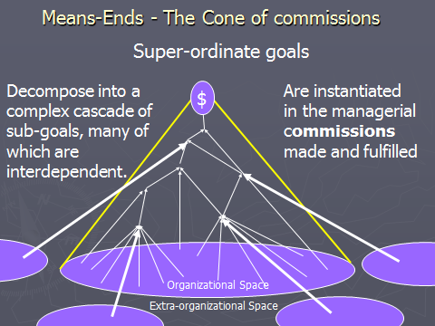
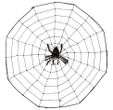

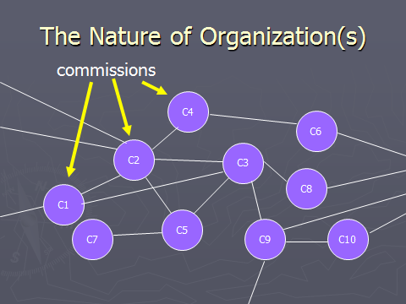
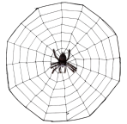

  Organizations as
  ever-evolving
  networks of commissions
  -a nexus of projects/plans
  -a web of webs
c
c
c

Slide 145
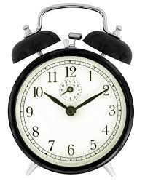
The Nature of Organization(s)
The constituent commissions of a commission web/network can be, and very often are, tightly coupled, not least in the temporal dimension:

Slide 146
The Nature of Organization(s)
commission webs/networks are tightly coupled, very often extensive and frequently complex.
Webs of commissions are pervaded by connectedness and interdependency in all their dimensions.

Slide 147
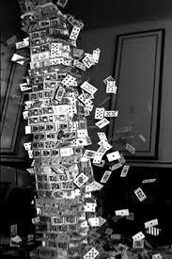

The Nature of Organization(s)
The loosely specified character of their constituent commissions but their tightly coupled character means commission networks/webs are highly precarious

Slide 148
The Nature of Organization(s)
“global went off their timeline again...everything kinda feeds off advertising ‘n what global are doing..y’know..if you’re not clear on that then that will knock back on everything else that you do...how do we get right and ready all the relevant materials to do a compelling account presentation for the sell-in that’s due if we haven’t got... well everything....there’s a real knock-on effect”

Slide 149
The Nature of Organization(s)
“..there’s been a load of confusion [Jim]..it’s not turned out the way we envisaged..basically now it’s too late to fix anyway, we’ve got to use what’s approved not what [Customer F] wants now..they should be here on Friday, if we get them back you will be able to use them...but [Simon] isn’t in ‘til Friday now so can’t ...don’t know when [Customer C] coming back on it now anyway so can’t hang it together now, [Paul] may know…but the [Xs] are due in on the fifteenth!”

Slide 150
The Nature of Organization(s)
Even if the scope & degree of specification of the individual commissions constituting a particular ‘web/network’ is reasonably comprehensive and tight, the overall scope & degree of specification of ‘webs of commissions’ is most often somewhat ‘loose’
This is the commission web/network equivalent of ‘engineering-tolerance stack-up’
Robustness helps but…..

Slide 151

The Nature of Organization(s)
commission webs/networks afford no ease or assurance in any dimension.
When they are effective, they are effective not simply because their constituent commissions may be authentic-robust but because they are constantly sustained.
The sustaining of commissions dominates managerial work

Slide 152
Sustaining commissions

Slide 153

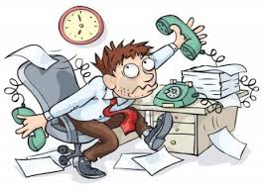

The Nature of Managerial Work
We agree with Tom Peters’ perspective on the centrality of ‘the mundane’ in effective managerial conduct
“The value of brute persistence may be vastly more important than the scarcity of references to it in the management literature would suggest” [1980 p 12].

Slide 154
Sustaining commissions

Slide 155


The Nature of Managerial Work
“..the actions of each manager affect all the other groups around him, and they must make adjustments before he can shift his own efforts. As one or more groups make what are, for him, less than optimal ‘moves’, our manager must make compensating moves.”
[Sayles 1964 p26-27]

Slide 156
The Nature of Managerial Work
These ‘moves’, in their turn, affect still other groups and so our peripatetic manager must go around the circuit again [and again & again ad infinitum] securing new agreements, commissions, [commitments] and assurances from those he had committed to something else only shortly before ….”
[Sayles 1964 p26-27 – re-wording highlighted]

Slide 157
Sustaining commissions
commissions are constantly being, both formally and informally, monitored and their meanings maintained and continually elaborated in all their dimensions:
“ ...lots, ‘n lots, ‘n lots of calls...a whole day of calls..talking to people, getting things done, making sure things were happening, chasing and chasing things
“...constant interaction to keep things on track...constantly I am saying ‘ what has happened with this and what has happened with that, and where are we up to, ‘n what needs to happen now...?”

Slide 158
Sustaining commissions

Slide 159
Sustaining commissions
Very often the achieved result of action taken, and even the action itself, differs substantially from that that was envisaged in its initiation.
“ What ‘looks good’ or practical or desirable at T1 often looks different a few days or weeks later, in the light of intervening information and events.” [Boden 1994 p191].
Most managerial policies spawn a set of unintended consequences, not only because of… complexity, but also because of the imperfections of language as a means of communication” [Clegg et al 2002 p491].

Slide 160
Sustaining commissions
The monitoring and maintenance of commissions is therefore accompanied by their continual modulation in the face of exigencies, discrepancies and unintended consequences of one form or another

Slide 161
Sustaining commissions
“...we originally said we were gonna put their [retailer’s] logo on the advertising..but we became less keen because as it ended up it was part of a bigger brand campaign and we had to back-track a little bit...we counterbalanced it with a real positive..we’ve sited the ‘six-sheets’ [posters] outside their sites..”
“..what I’ll try to do then is on the basis of this, I’ll try to bail us out of the second lot of product..if I can..this is another one where we’d probably have ordered just 200 but when everyone gets in a room and gets excited it goes to 1500..and everyone was right up for it at the time..then now all of a sudden!...”

Slide 162
Sustaining commissions
Modulations can at times represent a re-crafting of an entire commission web/network:
“[Thursday].. managed to get the MD to say yes, to sign off two and half million pounds, got the FD to say yes, got the Euro-Marketing Director to say yes. so we all said yes. ..went to London.. said to the agency book the TV ‘n let's be really clear on the outdoor, went off and started to book things.. by the Monday we then had to find a $2 million saving...”

Slide 163
Sustaining commissions
This maintaining and modulating of all commissions, even of those supposedly institutionalised webs of commissions that constitute ‘business processes’, is a perpetual activity, which at times does not necessarily receive what might be seen as the requisite level of attention:
“..sometimes there are very dangerous assumptions about what is or is not being progressed”

Slide 164
Sustaining commissions

Slide 165

Sustaining commissions
Systems, rules and procedures, among other mechanisms, are all utilized to mitigate the precariousness of commission webs in any repetitive activities

Slide 166
Sustaining commissions

Slide 167
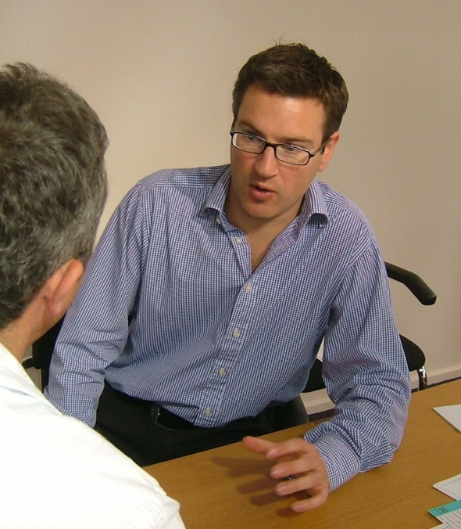
Sustaining commissions
“ ..lots of time is just spent with the team...constantly giving them input, not just imposing myself on them, but constantly giving them my input on what we should do, giving my view on what they’re doing, on how we overcome an issue”
The commission sustaining strand of conduct is pervaded by:
  Consulting - the giving and receiving of input [guidance] in the ‘what’ [‘technical’] dimension of commissions
  Coaching – the giving and receiving of input in the ‘how’ [‘method’] dimension of commissions

Slide 168
Sustaining commissions

Slide 169
Sustaining commissions
The sustaining strand of conduct includes the cultivating of the relationships that underpin the effective shaping and sustaining of commissions
‘networking’.. “..[the] developing [of] a network of co-operative relationships to and among those people they felt were actually needed to accomplish their emerging agendas” [Kotter 1986 p67].
One could say that the commissions of the model are the currency of collaboration and of social capital, and that robust, authentic and fulfilled commissions represent the interest on the latter.

Slide 170
Sustaining commissions
Compliance with norms [e.g. authority], procedures and the seeking of continuance may be heavily represented in individual rationales for the acceptance and fulfilling of commissions, but the influence of emotional factors is strong:
“ I’m only doing this for you y’know; if it was anybody else I’d...”
In the turbulent situations of the studied managers the authentic & strong-but-flexible commitment to commissions generated by such affective rationale proves invaluable.

